Slide 1


Lecture 2-2
DLI
Fixed-Point Iteration
Finding solutions to fixed-point problems
Finding the connection between the fixed-point problems and the root-finding problems

Slide 2



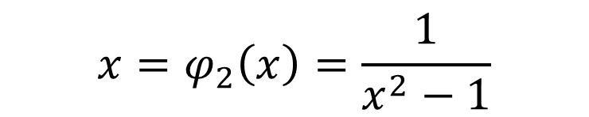
DLI
Iteration: $x_{k+1}=φ(x_{k})$
Equivalence Problem: $f\left(x\right)=0⇔x=φ(x)$
Example: $f\left(x\right)=x^{3}−x−1=0$
$$x=φ_{1}\left(x\right)=\sqrt[3]{x+1}$$
$$x=φ_{2}\left(x\right)=\frac{1}{x^{2}−1}$$
$$x=φ_{3}\left(x\right)=x^{3}−1$$
Which one is better?

Slide 3
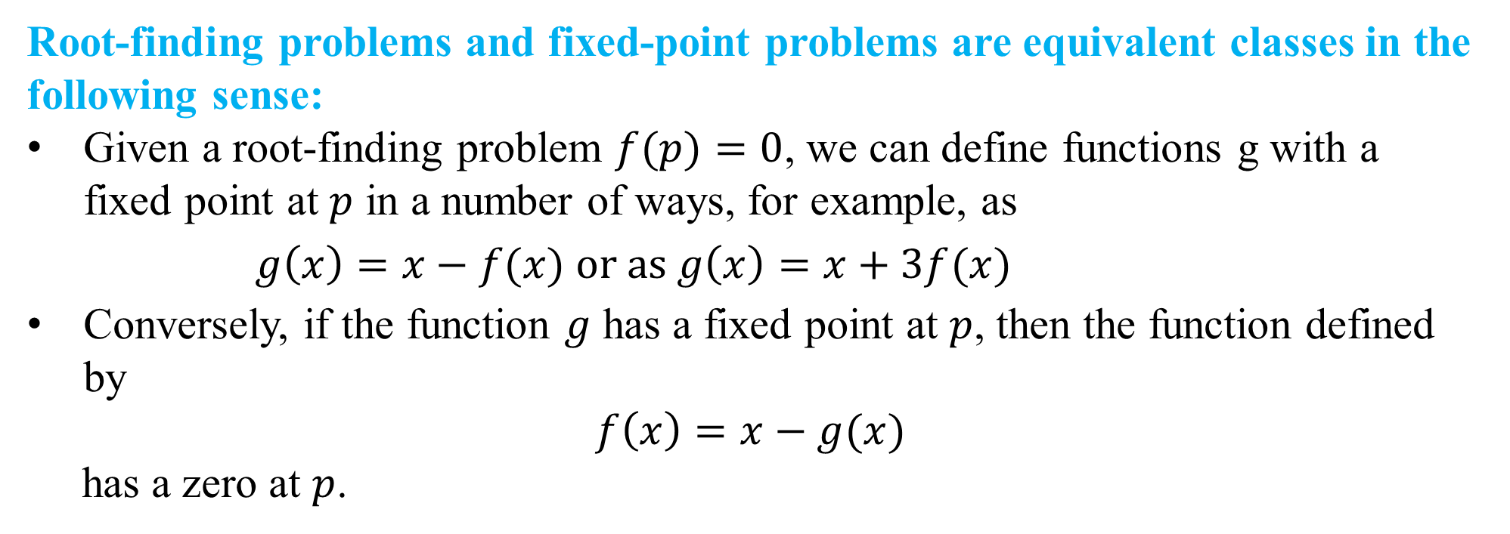
DLI
Definition 2.2 The number $p$ is a fixed point for a given function $g$ if $g(p)=p.$
Root-finding problems and fixed-point problems are equivalent classes in the following sense:
Given a root-finding problem $f(p)=0$, we can define functions g with a fixed point at $p$ in a number of ways, for example, as
$g\left(x\right)=x−f(x)$ or as $g\left(x\right)=x+3f(x)$
Conversely, if the function $g$ has a fixed point at $p$, then the function defined by
$$f\left(x\right)=x−g(x)$$
has a zero at $p$.

Slide 4
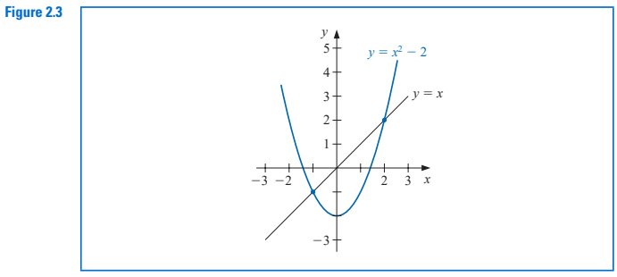
DLI
Example 1：Determine any fixed points of the function $g(x)=x^{2}−2$.

Slide 5
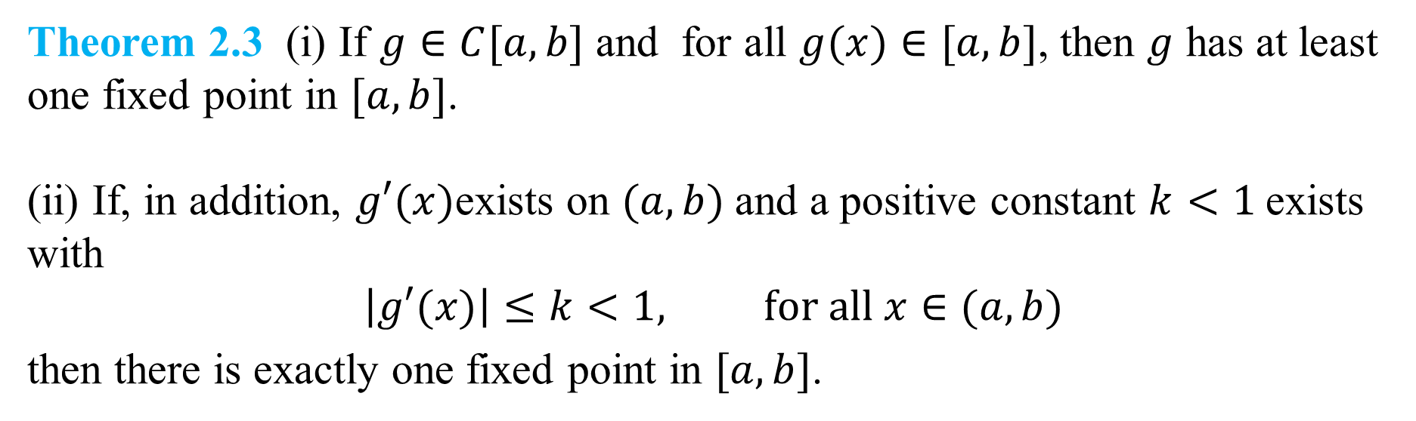
DLI
Existence and uniqueness of a fixed point
Theorem 2.3 (i) If $g∈C[a,b]$ and for all $g(x)∈[a,b]$, then $g$ has at least one fixed point in $[a,b]$.
(ii) If, in addition, $g′(x)$exists on $(a,b)$and a positive constant $k<1$exists with
$$\left|g′(x)\right|≤k<1, for all x∈(a,b)$$
then there is exactly one fixed point in $[a,b]$.
Note: The theorem gives sufficient conditions for the existence and uniqueness of a fixed point.

Slide 6
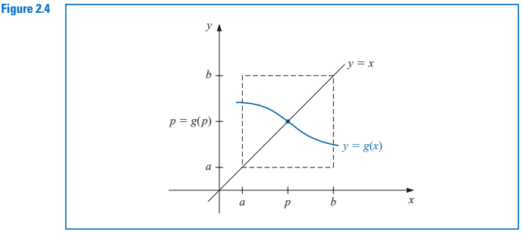
DLI

Slide 7
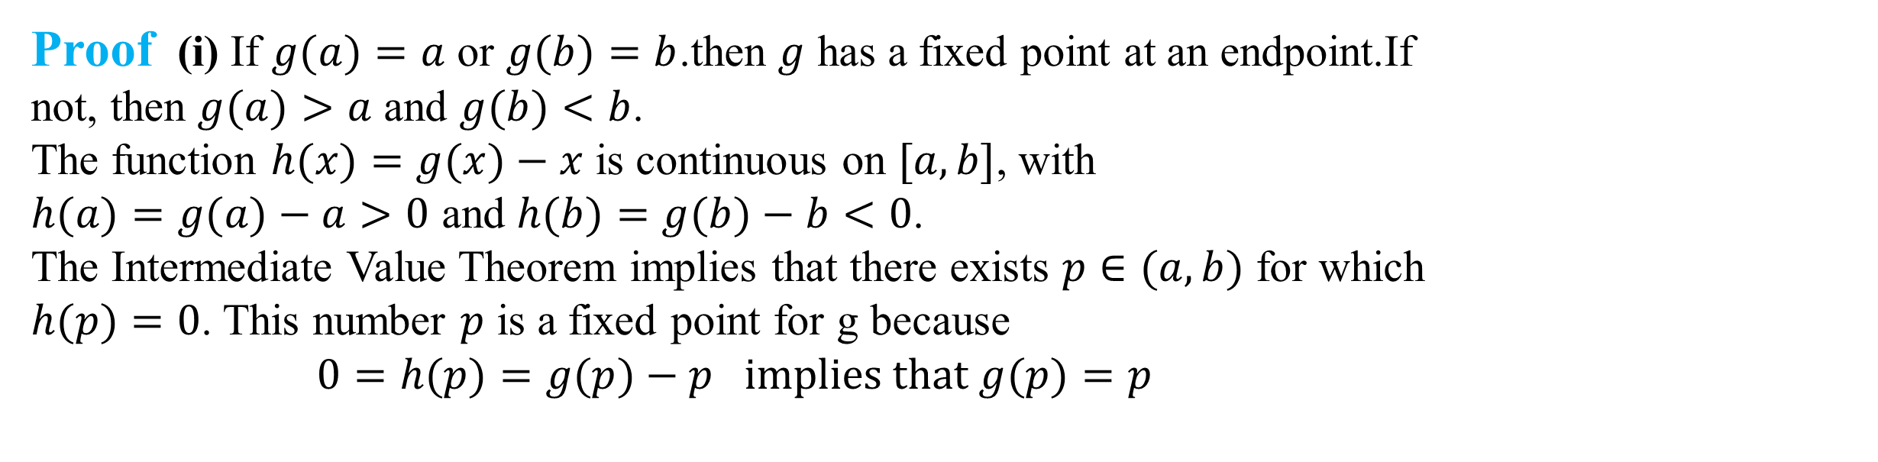
DLI
Proof (i) If $g(a)=a$ or $g(b)=b$.then $g$ has a fixed point at an endpoint.If not, then $g(a)>a$ and $g(b)<b$.
The function $h(x)=g(x)−x$ is continuous on $[a,b]$, with
$h(a)=g(a)−a>0$ and $h(b)=g(b)−b<0$.
The Intermediate Value Theorem implies that there exists $p∈(a,b)$ for which $h(p)=0$. This number $p$ is a fixed point for g because
$$0=h(p)=g(p)−p implies that g(p)=p$$

Slide 8
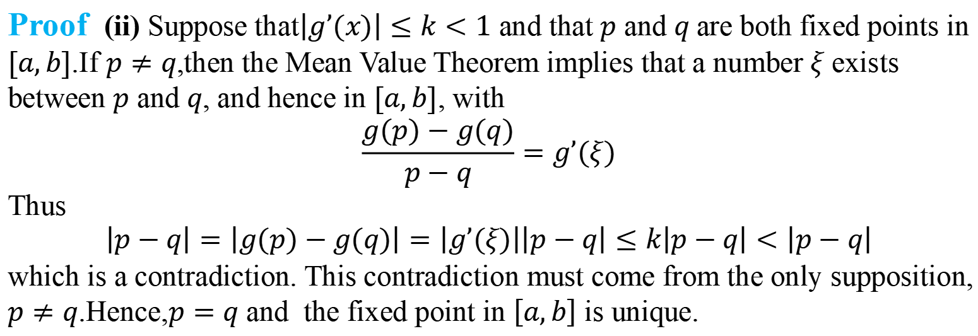
DLI
Proof (ii) Suppose that$\left|g’(x)\right|≤k<1$ and that $p$ and $q$are both fixed points in $[a,b]$.If $p≠q$,then the Mean Value Theorem implies that a number $ξ$ exists between $p$ and $q$, and hence in $[a,b]$, with
$$\frac{g(p)−g(q)}{p−q}=g’(ξ)$$
Thus
$$\left|p−q\right|=\left|g(p)−g(q)\right|=\left|g’(ξ)\right|\left|p−q\right|≤k\left|p−q\right|<\left|p−q\right|$$
which is a contradiction. This contradiction must come from the only supposition,
$p≠q$.Hence,$p=q$ and the fixed point in $\left[a,b\right]$ is unique.

Slide 9
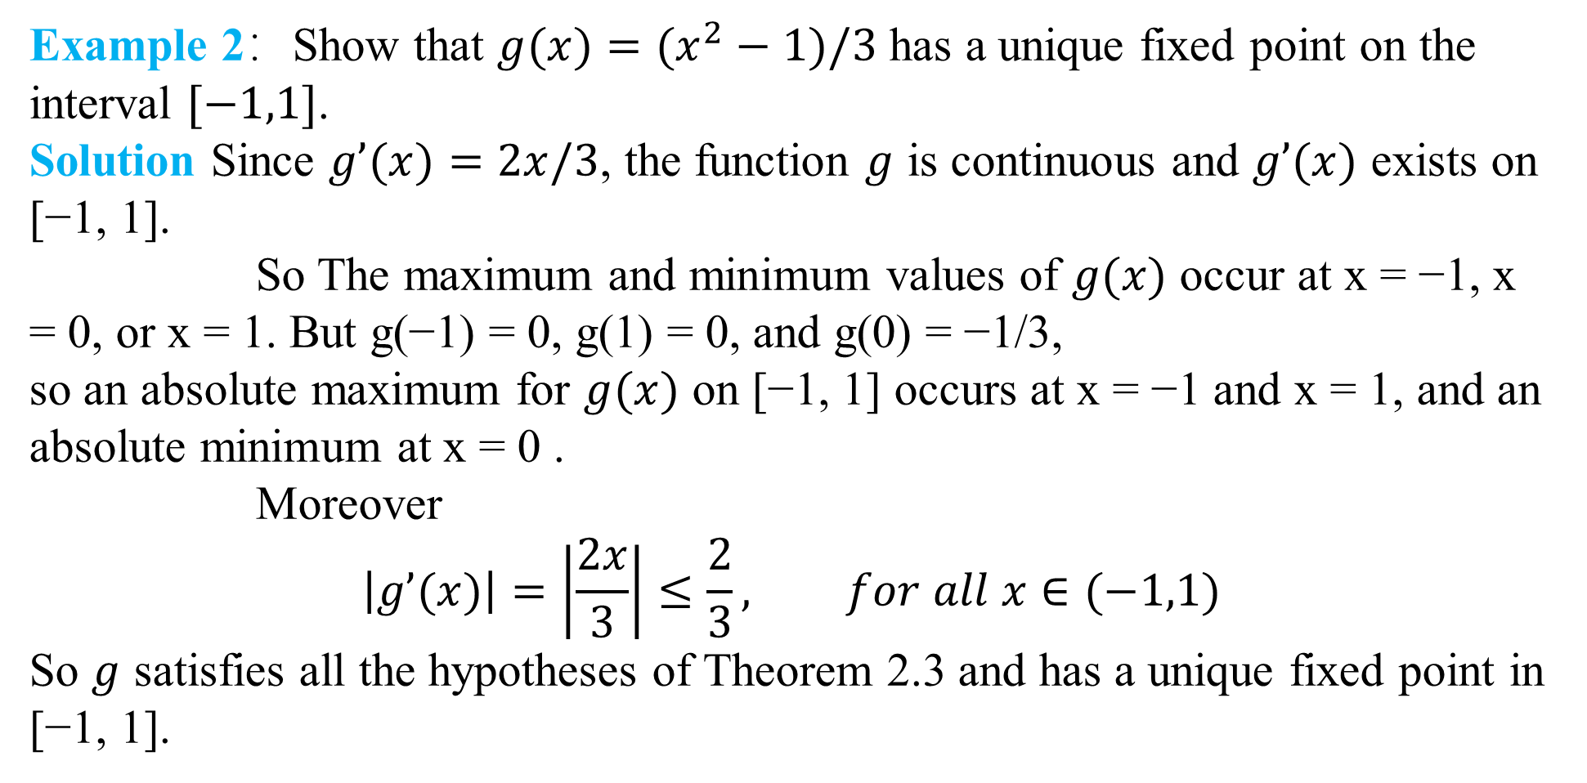
DLI
Example 2：Show that $g(x)=(x^{2}−1)/3$ has a unique fixed point on the interval $[−1,1]$.
Solution Since $g’(x)=2x/3$, the function $g$ is continuous and $g’(x)$ exists on [−1, 1].
So The maximum and minimum values of $g(x)$ occur at x = −1, x = 0, or x = 1. But g(−1) = 0, g(1) = 0, and g(0) = −1/3,
so an absolute maximum for $g(x)$ on [−1, 1] occurs at x = −1 and x = 1, and an absolute minimum at x = 0 .
Moreover
$$\left|g’(x)\right|=\left|\frac{2x}{3}\right|≤\frac{2}{3}, for all x∈(−1,1)$$
So $g$ satisfies all the hypotheses of Theorem 2.3 and has a unique fixed point in [−1, 1].

Slide 10
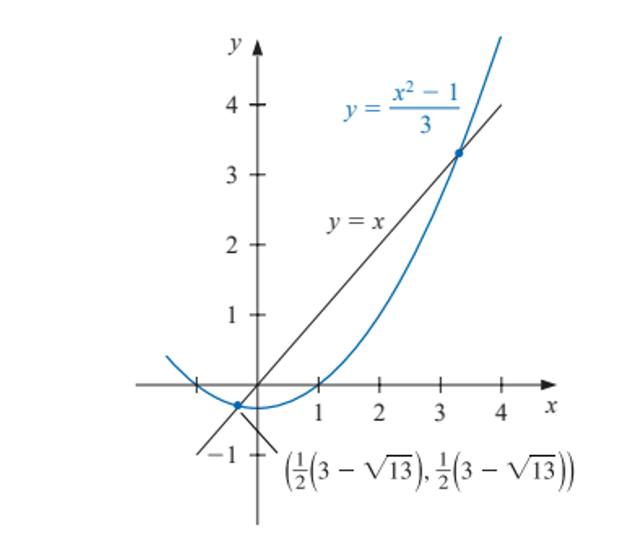

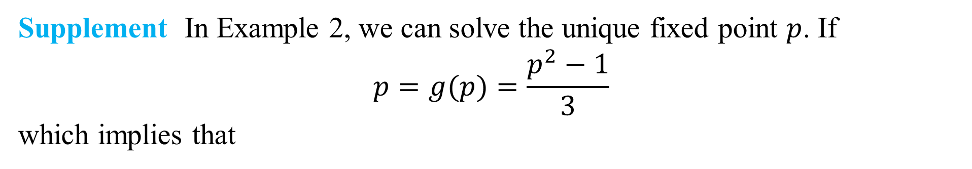
DLI
Supplement In Example 2, we can solve the unique fixed point $p$. If
$$p=g(p)=\frac{p^{2}−1}{3}$$
which implies that
$$p=\frac{1}{2}(3−\sqrt{13})$$

Slide 11
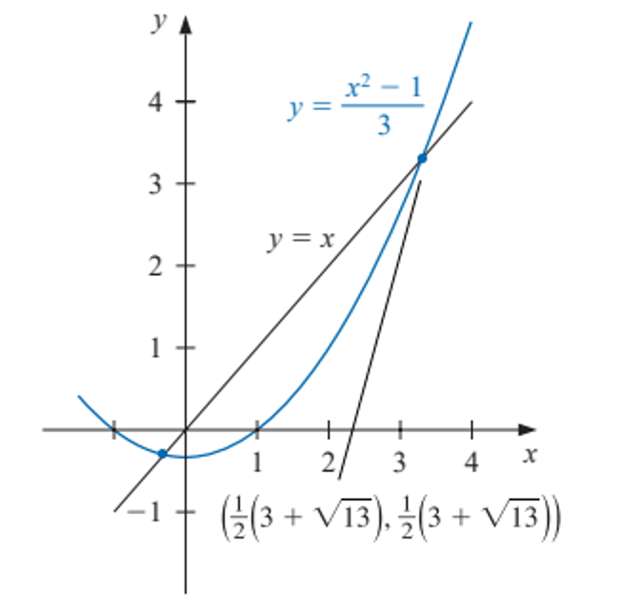
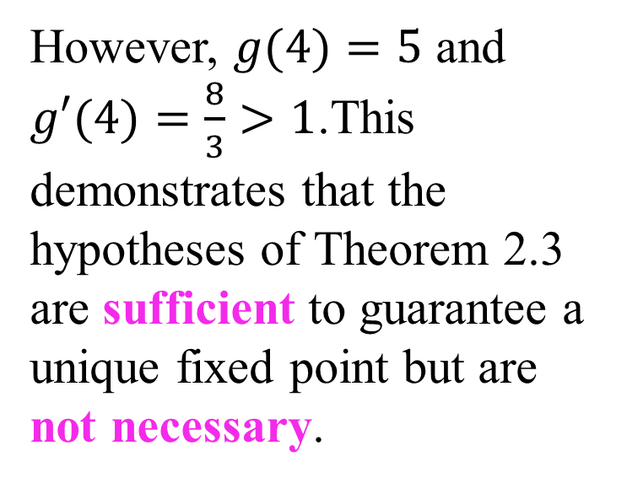

DLI
Supplement
$g$ also has a unique fixed point $p=\frac{1}{2}(3+\sqrt{13})$ for the interval [3, 4].
However, $g(4)=5$ and $g′(4)=\frac{8}{3}>1$.This demonstrates that the hypotheses of Theorem 2.3 are sufficient to guarantee a unique fixed point but are not necessary.

Slide 12
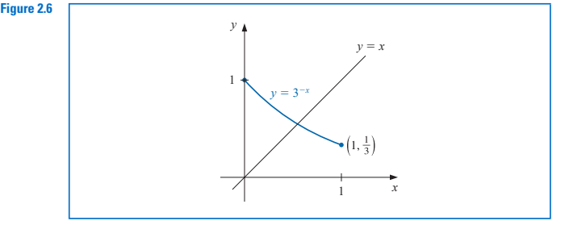
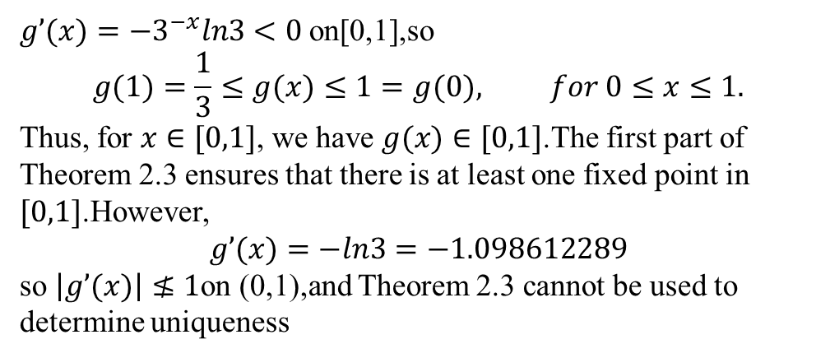
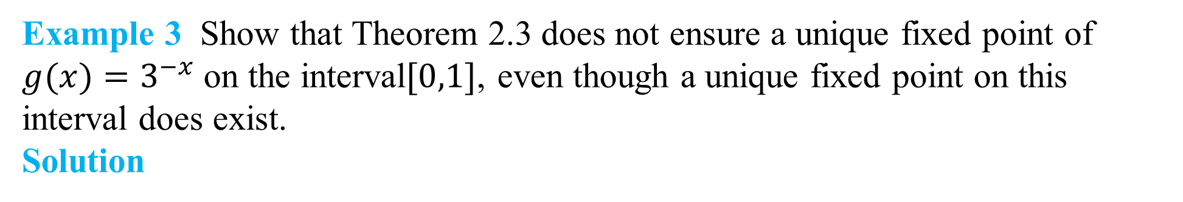
DLI
Example 3 Show that Theorem 2.3 does not ensure a unique fixed point of $g(x)=3^{−x}$on the interval$[0,1]$, even though a unique fixed point on this interval does exist.
Solution
$g’(x)={−3}^{−x}ln3<0$on[0,1],so
$$g(1)=\frac{1}{3}≤g(x)≤1=g(0), for 0≤x≤1.$$
Thus, for $x∈[0,1]$, we have $g(x)∈[0,1]$.The first part of Theorem 2.3 ensures that there is at least one fixed point in $[0,1]$.However,
$$g’(x)=−ln3=−1.098612289$$
so $\left|g’(x)\right|≰1$on (0,1),and Theorem 2.3 cannot be used to determine uniqueness

Slide 13
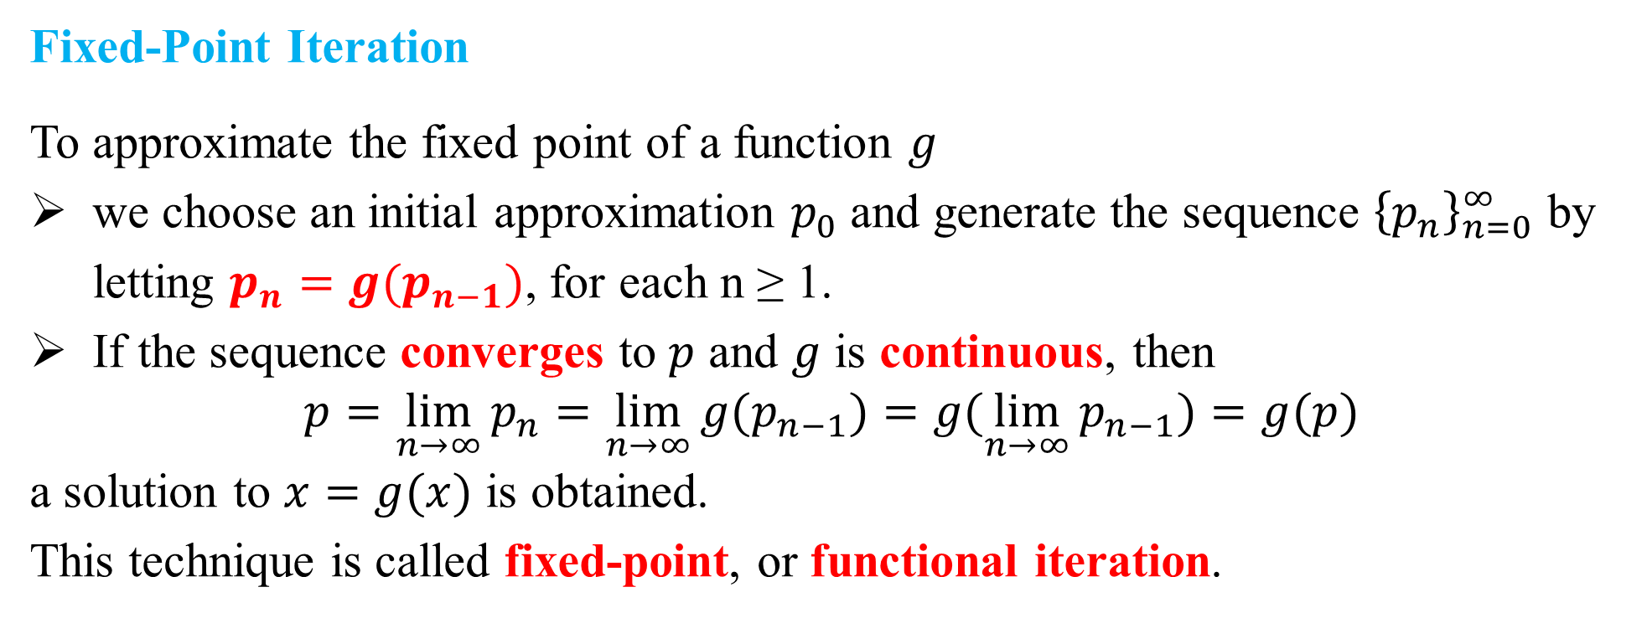
DLI
Fixed-Point Iteration
To approximate the fixed point of a function $g$
we choose an initial approximation $p_{0}$and generate the sequence ${\left\{p_{n}\right\}}_{n=0}^{∞}$ by letting $p_{n}=g(p_{n−1})$, for each n ≥ 1.
If the sequence converges to $p$ and $g$ is continuous, then
$$p=\lim_{n→∞}{p_{n}=\lim_{n→∞}{g(p_{n−1})=g(\lim_{n→∞}{p_{n−1}})=g(p)}}$$
a solution to $x=g(x)$ is obtained.
This technique is called fixed-point, or functional iteration.

Slide 14
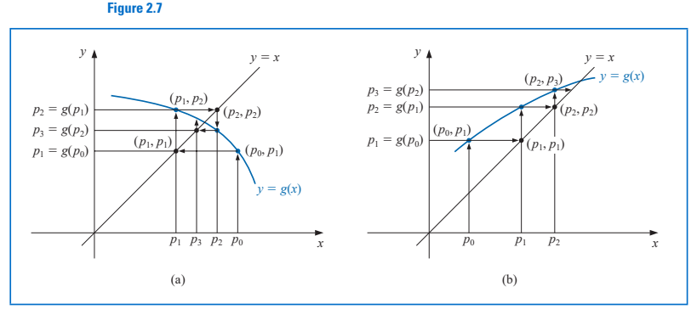
DLI
Fixed-point iteration process

Slide 15
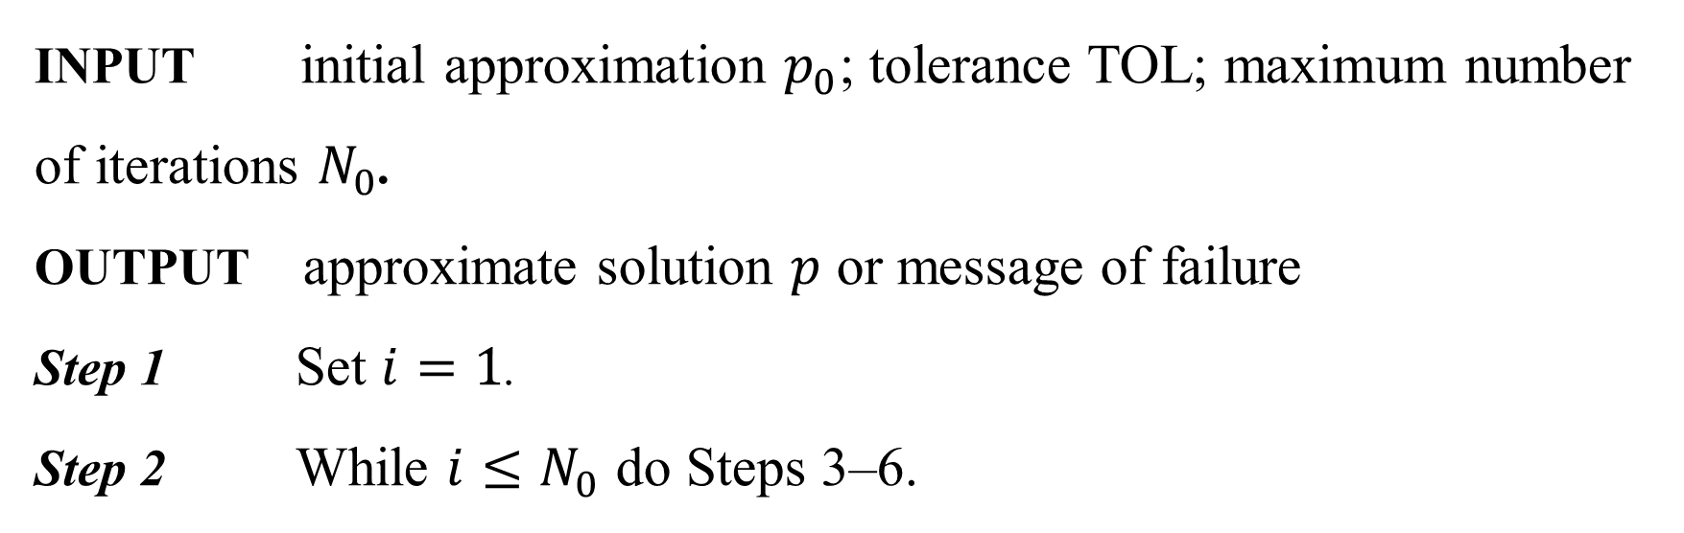

DLI
Fixed-point iterative algorithm
To find a solution to $p=g(p)$ given an initial approximation $p_{0}$.
INPUT initial approximation $p_{0}$; tolerance TOL; maximum number of iterations $N_{0}$.
OUTPUT approximate solution $p$ or message of failure
Step 1 Set $i=1$.
Step 2 While $i≤N_{0}$ do Steps 3–6.

Slide 16
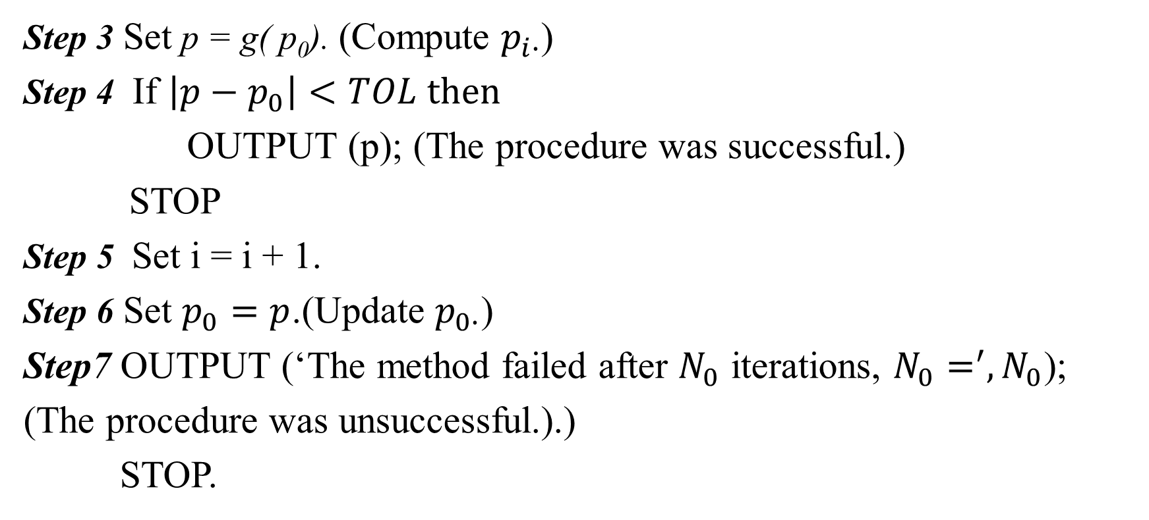
DLI
Step 3 Set p = g( p₀). (Compute $p_{i∙}$)
Step 4 If $\left|p−p_{0}\right|<TOL then$
OUTPUT (p); (The procedure was successful.)
STOP
Step 5 Set i = i + 1.
Step 6 Set $p_{0}=p$.(Update $p_{0∙}$)
Step7 OUTPUT (‘The method failed after $N_{0}$ iterations, $N_{0}=^{′}, N_{0}$);
(The procedure was unsuccessful.).)
STOP.

Slide 17
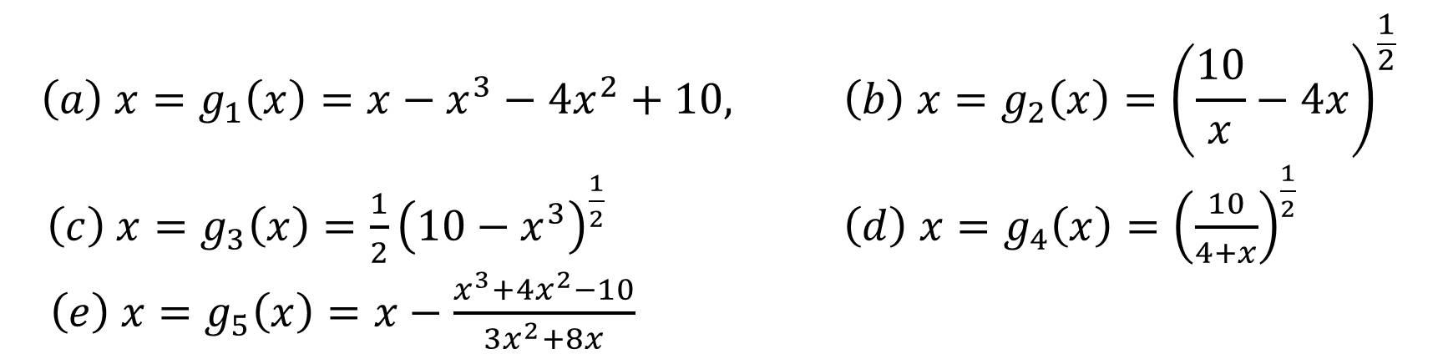

DLI
Illustration
The equation $x^{3}+4x^{2}−10=0$ has a unique root in $[1,2]$.
$$\left(a\right) x=g_{1}\left(x\right)=x−x^{3}−4x^{2}+10, \left(b\right) x=g_{2}\left(x\right)={\left(\frac{10}{x}−4x\right)}^{\frac{1}{2}}$$
$\left(c\right) x=g_{3}\left(x\right)=\frac{1}{2}{\left(10−x^{3}\right)}^{\frac{1}{2}}$ $\left(d\right) x=g_{4}\left(x\right)={\left(\frac{10}{4+x}\right)}^{\frac{1}{2}}$
$\left(e\right) x=g_{5}\left(x\right)=x−\frac{x^{3}+4x^{2}−10}{3x^{2}+8x}$

Slide 18
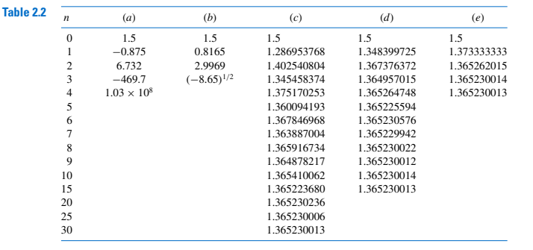
DLI
With $p_{0}=1.5$

Slide 19
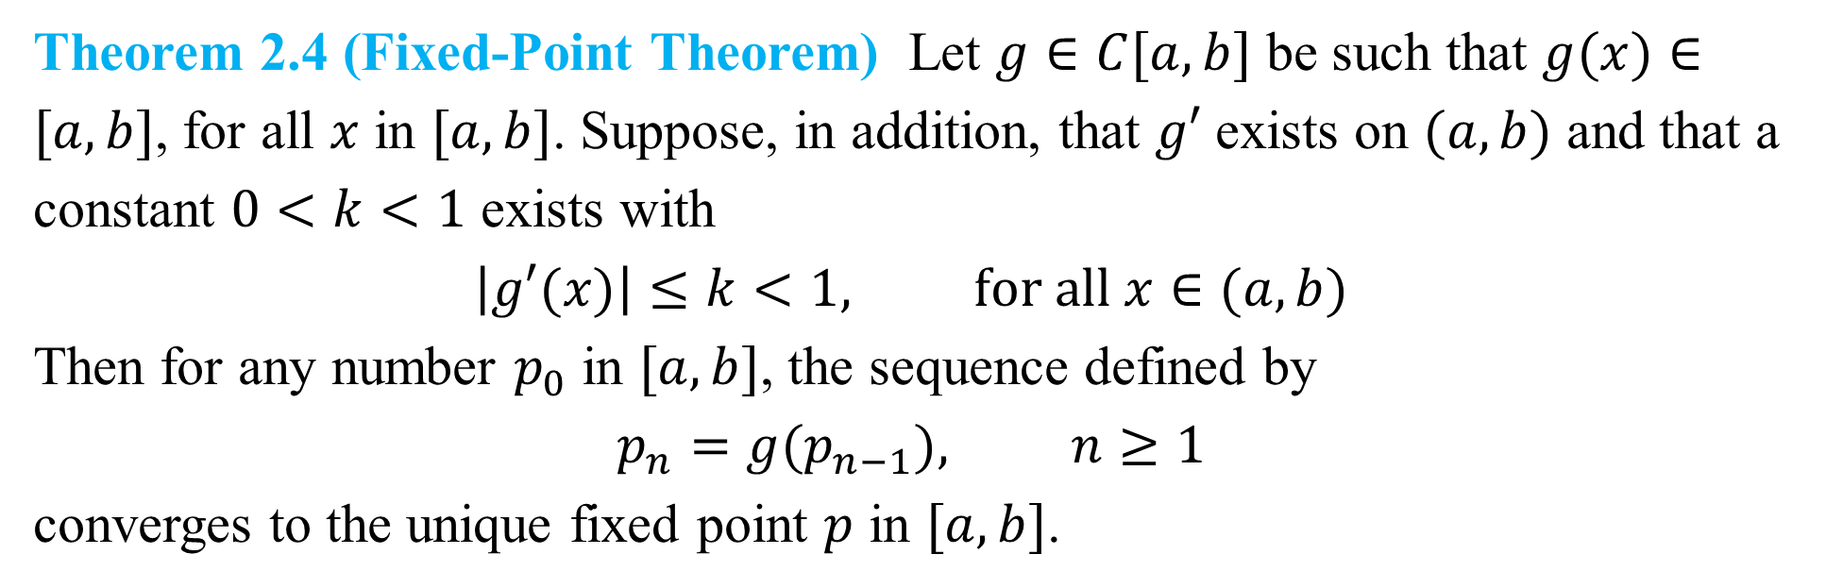
DLI
Question: How can we find a fixed-point problem that produces a sequence that reliably and rapidly converges to a solution to a given root-finding problem?
Theorem 2.4 (Fixed-Point Theorem) Let $g∈C[a,b]$ be such that $g(x)∈[a,b]$, for all $x$ in $[a,b]$. Suppose, in addition, that $g′$exists on $(a,b)$ and that a constant $0<k<1$ exists with
$$\left|g′(x)\right|≤k<1, for all x∈(a,b)$$
Then for any number $p_{0}$ in $[a,b]$, the sequence defined by
$$p_{n}=g(p_{n−1}), n≥1$$
converges to the unique fixed point $p$ in $[a,b]$.

Slide 20
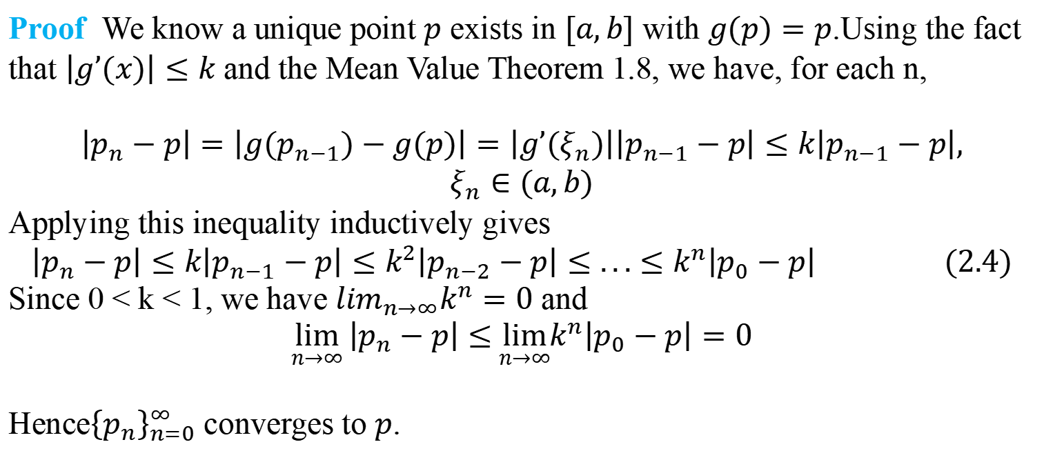
DLI
Proof We know a unique point $p$ exists in $[a,b]$ with $g(p)=p$.Using the fact that $\left|g’(x)\right|≤k$ and the Mean Value Theorem 1.8, we have, for each n,
$$\left|p_{n}−p\right|=\left|g(p_{n−1})−g(p)\right|=\left|g’(ξ_{n})\right|\left|p_{n−1}−p\right|≤k\left|p_{n−1}−p\right|,$$
$$ξ_{n}∈(a,b)$$
Applying this inequality inductively gives
$$\left|p_{n}−p\right|≤k\left|p_{n−1}−p\right|≤k^{2}\left|p_{n−2}−p\right|≤...≤k^{n}\left|p_{0}−p\right| (2.4)$$
Since 0 < k < 1, we have $\lim_{n→∞}k^{n}=0$ and
$$\lim_{n→∞}\left|p_{n}−p\right|≤\lim_{n→∞}k^{n}\left|p_{0}−p\right|=0$$
Hence${\left\{p_{n}\right\}}_{n=0}^{∞}$ converges to $p$.

Slide 21
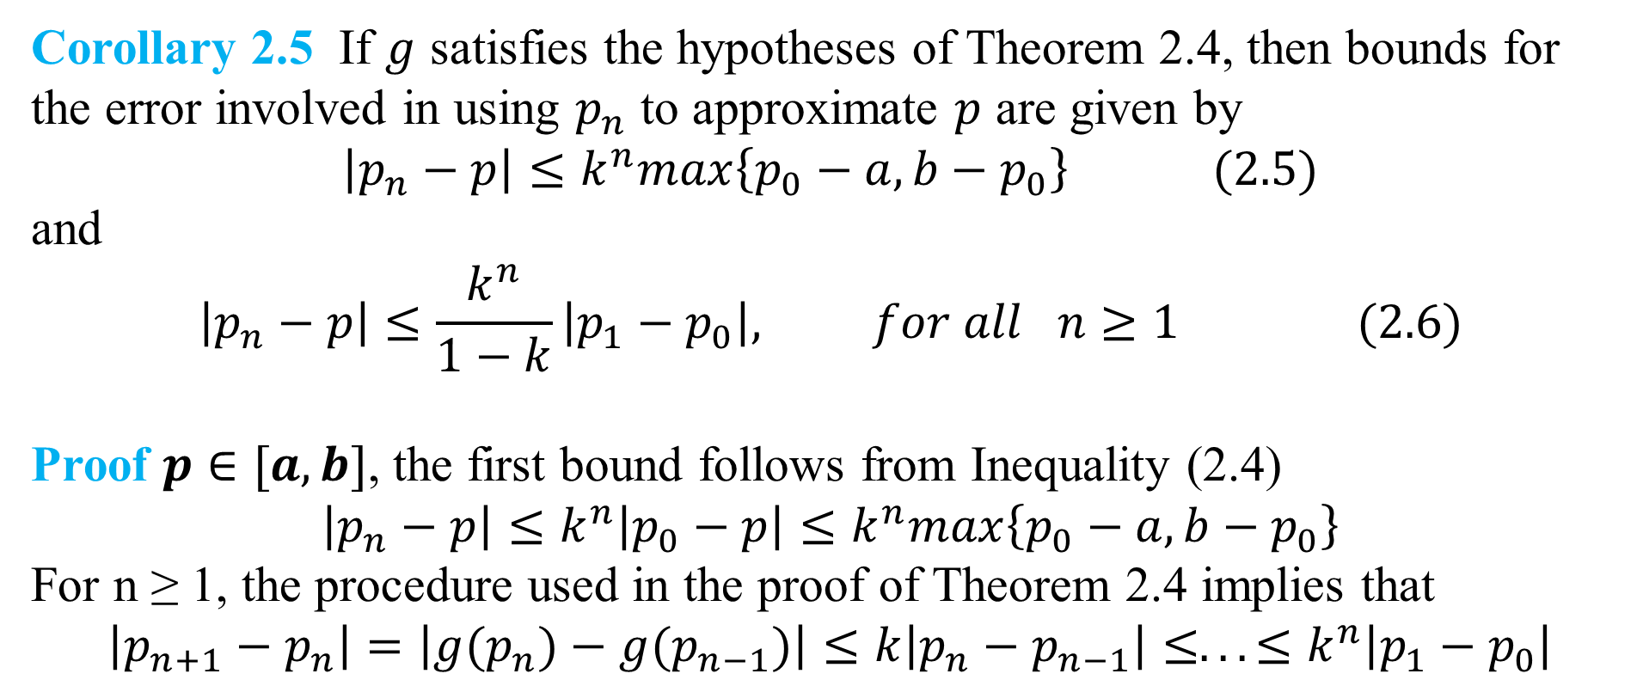
DLI
Corollary 2.5 If $g$ satisfies the hypotheses of Theorem 2.4, then bounds for the error involved in using $p_{n}$ to approximate $p$ are given by
$$\left|p_{n}−p\right|≤k^{n}max\left\{p_{0}−a,b−p_{0}\right\} (2.5)$$
and
$$\left|p_{n}−p\right|≤\frac{k^{n}}{1−k}\left|p_{1}−p_{0}\right|, for all n≥1 (2.6)$$
Proof $p∈[a,b]$, the first bound follows from Inequality (2.4)
$$\left|p_{n}−p\right|≤k^{n}\left|p_{0}−p\right|≤k^{n}max\left\{p_{0}−a,b−p_{0}\right\}$$
For n ≥ 1, the procedure used in the proof of Theorem 2.4 implies that
$$\left|p_{n+1}−p_{n}\right|=\left|g(p_{n})−g(p_{n−1})\right|≤k\left|p_{n}−p_{n−1}\right|≤...≤k^{n}\left|p_{1}−p_{0}\right|$$

Slide 22
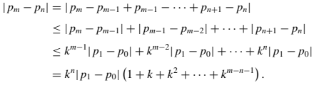

DLI
Continued
Thus for m > n ≥ 1,
By Theorem 2.3,

Slide 23
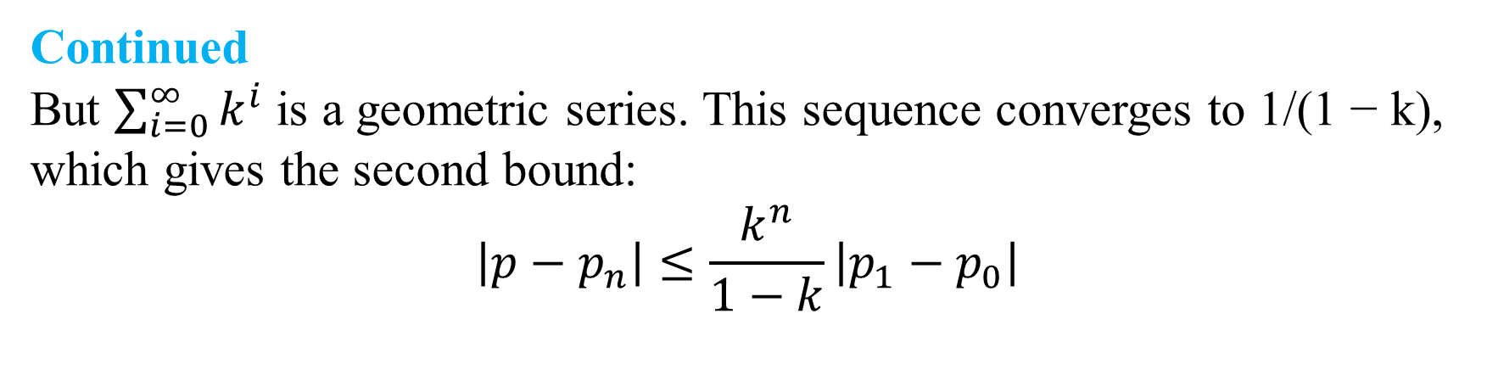
DLI
Continued
But $\sum_{i=0}^{∞}{k^{i}}$ is a geometric series. This sequence converges to 1/(1 − k), which gives the second bound:
$$\left|p−p_{n}\right|≤\frac{k^{n}}{1−k}\left|p_{1}−p_{0}\right|$$

Slide 24
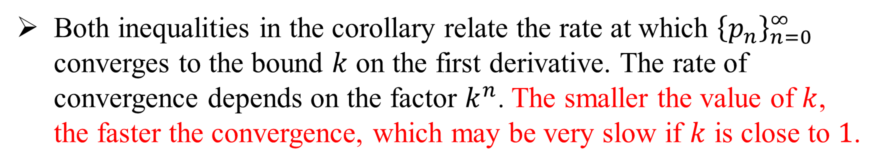
DLI
Both inequalities in the corollary relate the rate at which ${\left\{p_{n}\right\}}_{n=0}^{∞}$ converges to the bound $k$ on the first derivative. The rate of convergence depends on the factor $k^{n}$. The smaller the value of $k$, the faster the convergence, which may be very slow if $k$ is close to $1$.

Slide 25
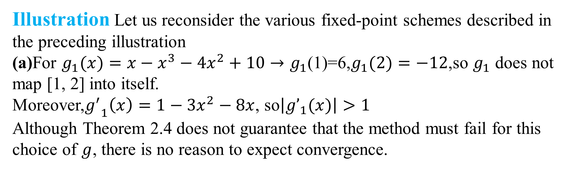
DLI
Illustration Let us reconsider the various fixed-point schemes described in the preceding illustration
(a)For $g_{1}(x)=x−x^{3}−4x^{2}+10→g_{1}$(1)=6,$g_{1}(2)=−12$,so $g_{1}$ does not map [1, 2] into itself.
Moreover,${g^{′}}_{1}\left(x\right)=1−3x^{2}−8x$, so$\left|{g’}_{1}(x)\right|>1$
Although Theorem 2.4 does not guarantee that the method must fail for this
choice of $g$, there is no reason to expect convergence.

Slide 26
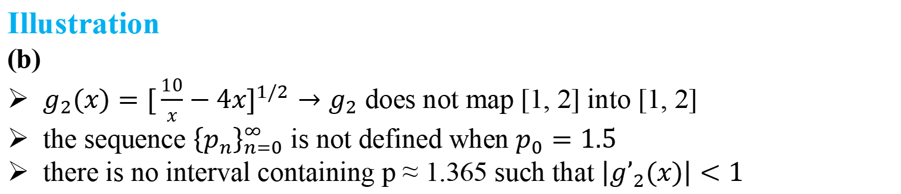
DLI
Illustration
(b)
$g_{2}(x)=[\frac{10}{x}−4x]^{1/2}→g_{2}$ does not map [1, 2] into [1, 2]
the sequence ${\left\{p_{n}\right\}}_{n=0}^{∞}$ is not defined when $p_{0}=1.5$
there is no interval containing p ≈ 1.365 such that $\left|{g’}_{2}(x)\right|<1$
There is no reason to expect that this method will converge.

Slide 27
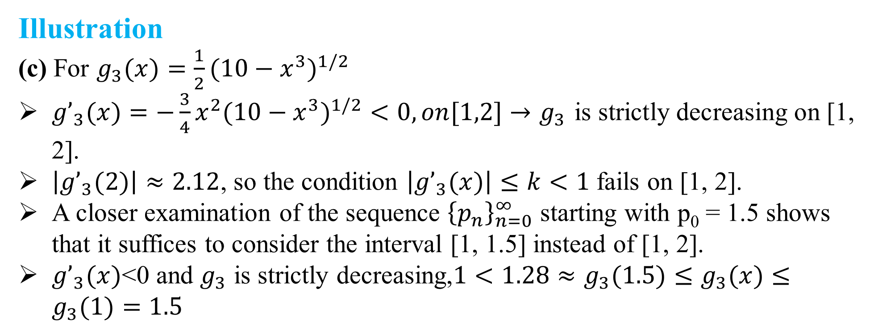
DLI
Illustration
(c) For $g_{3}(x)=\frac{1}{2}(10−x^{3})^{1/2}$
${g’}_{3}(x)=−\frac{3}{4}x^{2}(10−x^{3})^{1/2}<0,on[1,2]→g_{3}$ is strictly decreasing on [1, 2].
$\left|{g’}_{3}(2)\right|≈2.12$, so the condition $\left|{g’}_{3}(x)\right|≤k<1$ fails on [1, 2].
A closer examination of the sequence ${\left\{p_{n}\right\}}_{n=0}^{∞}$ starting with p₀ = 1.5 shows that it suffices to consider the interval [1, 1.5] instead of [1, 2].
${g’}_{3}(x)$<0 and $g_{3}$ is strictly decreasing,$1<1.28≈g_{3}(1.5)≤g_{3}(x)≤g_{3}(1)=1.5$

Slide 28
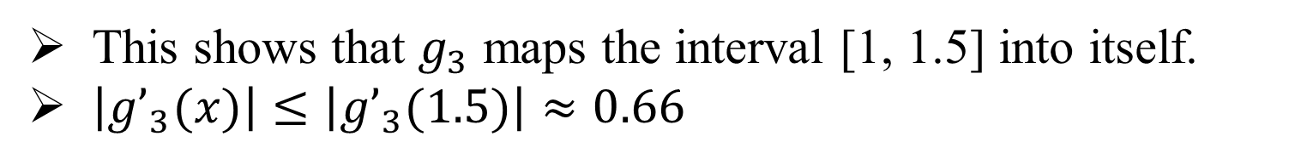
DLI
This shows that $g_{3}$ maps the interval [1, 1.5] into itself.
$\left|{g’}_{3}(x)\right|≤\left|{g’}_{3}(1.5)\right|≈0.66$
so Theorem 2.4 confirms the convergence of which we were already aware.

Slide 29
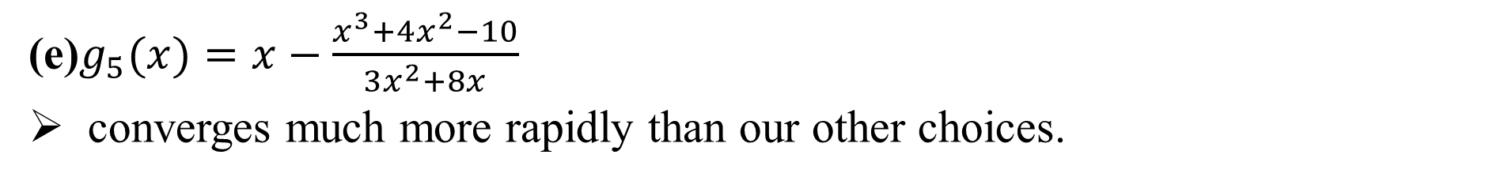
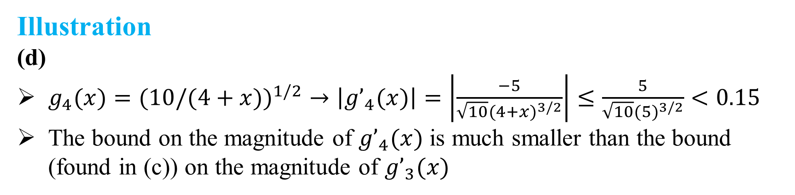
DLI
Illustration
(d)
$g_{4}(x)=(10/(4+x{))}^{1/2}→\left|{g’}_{4}(x)\right|=\left|\frac{−5}{\sqrt{10}(4+x)^{3/2}}\right|≤\frac{5}{\sqrt{10}(5)^{3/2}}<0.15$
The bound on the magnitude of ${g’}_{4}(x)$ is much smaller than the bound (found in (c)) on the magnitude of ${g’}_{3}(x)$
This explains the more rapid convergence using $g_{4}$.
(e)$g_{5}(x)=x−\frac{x^{3}+4x^{2}−10}{3x^{2}+8x}$
converges much more rapidly than our other choices.

Slide 30
DLI
Question: How can we find a fixed-point problem that produces a sequence that reliably and rapidly converges to a solution to a given root-finding problem?
Answer: Manipulate the root-finding problem into a fixed point problem that satisfies the conditions of Fixed-Point Theorem 2.4 and has a derivative that is as small as possible near the fixed point.

